Slide 1
Physics 1 – Oct 11, 2018
P3 Challenge –
Romeo is chucking pebbles gently up to Juliet’s window, and he want the pebble to hit the window horizontally. He is standing at the edge of a garden at the base of her window that is 9.0 m wide and her window is 8.0 m high. How fast are the pebbles going when they hit the window?
Get out Projectile HWK for check.

Slide 2
Objectives, Agenda, Assignment
IB 2.1 Motion (in 2D)
  Projectile Motion
  Motion on an incline
Agenda
  Range Equation – time with last two problems
  Homework review on white boards with groups
  Lab 1: Acceleration on an incline information
  General IB Lab Report Format
Assignment:
  Prepare your procedure and data table for the lab next time
  Begin writing your lab report.

Slide 3
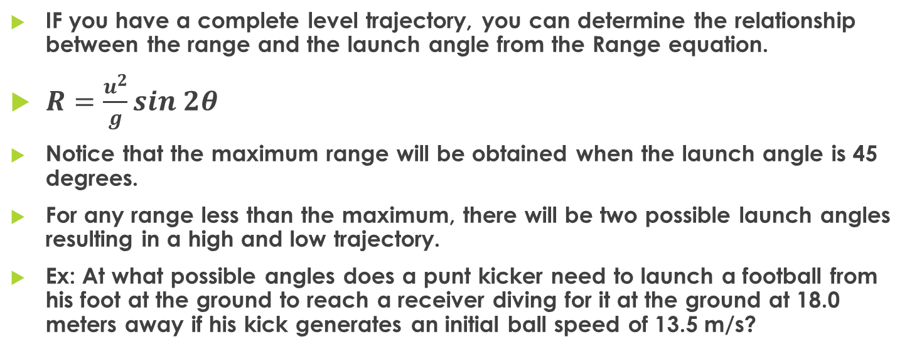
Range Equation
IF you have a complete level trajectory, you can determine the relationship between the range and the launch angle from the Range equation.
$R=\frac{u^{2}}{g}sin 2θ$
Notice that the maximum range will be obtained when the launch angle is 45 degrees.
For any range less than the maximum, there will be two possible launch angles resulting in a high and low trajectory.
Ex: At what possible angles does a punt kicker need to launch a football from his foot at the ground to reach a receiver diving for it at the ground at 18.0 meters away if his kick generates an initial ball speed of 13.5 m/s?

Slide 4
Motion on an incline lab.
Overview
Motion on an incline could be treated as 1D motion or 2D motion.
  If you use the incline as the frame of reference, you can consider it 1D and measure a cart’s acceleration.
  If you use a traditional Up-down-left-right frame of reference, it is 2D.
In the 2D form, we can resolve the motion of an object on an incline into two useful directions other than the usual x and y. Namely, the parts of the motion that are parallel to the incline and which are perpendicular to the incline.
90 - θ
θ
g cos θ = a⊥
θ
g
g sin θ = a

Slide 5
Motion on an incline lab.
For the lab, you will use a cart rolling down an incline to asses the value of g = the acceleration of freefall.
This task is the first of the required labs for IB and must be completed with a lab report based off of the IB General Lab Format.
  “2.1 Determining the acceleration of free-fall experimentally” is the official task. There are many ways to do this. We are going to do it using an incline.

Slide 6
General Lab Format
1. Aims
2. Methods and Tools
3. Data Collection
4. Data Processing and Presentation
5. Conclusion and Evaluation
For effective communication with IB, your reports should include each of these sections, indicated with subheadings. Use two dates: the date the experiment was done, and the date the report was written/submitted. Reports are due one week after lab work is completed. Reports submitted after 1 week will be late.

Slide 7
Variables
Independent Variables: Those that you choose to vary in a systematic way.
  Determine how many different levels of an IV will you use.
  How many trials will you perform at each IV level? Minimum = 3. Convenient = 5 to 10. Statistically sound = 30.
  Control. A level of the IV when the IV is not present. Sometimes only a thought exercise, but measure if you can.
Dependent Variables: Those that you measure as a consequence of some action.
Control Variables: Variables that could effect the measurement of your DV. Keep these variables constant for all trials. Often the values of control variables will be used in calculations.

Slide 8
Data Tables
When designing your data table, consider the procedure you will use and visualize what measurements you will need to record. ONLY PHYSICAL MEASUREMENTS THAT YOU MAKE DURING LAB SHOULD BE LISTED IN A DATA TABLE!!!!
Often it is useful to create a table to collect repetitive calculations that need to be done, too. These calculation tables belong in the data processing section, NOT the Data Collection section.

Slide 9
Motion on an incline lab.
Feel free to work with the sample setup to determine how best to proceed.
What other materials will you need?
Perhaps do a trial run.

Slide 10
Exit Slip - Assignment
Exit Slip – Clean up white boards and put away.
What’s Due? (Pending assignments to complete.)
  Prepare your procedure and data table for the lab next time
  Begin writing your lab report.
What’s Next? (How to prepare for the next day)
  Time for the Acceleration on an incline lab.

